Slide 1

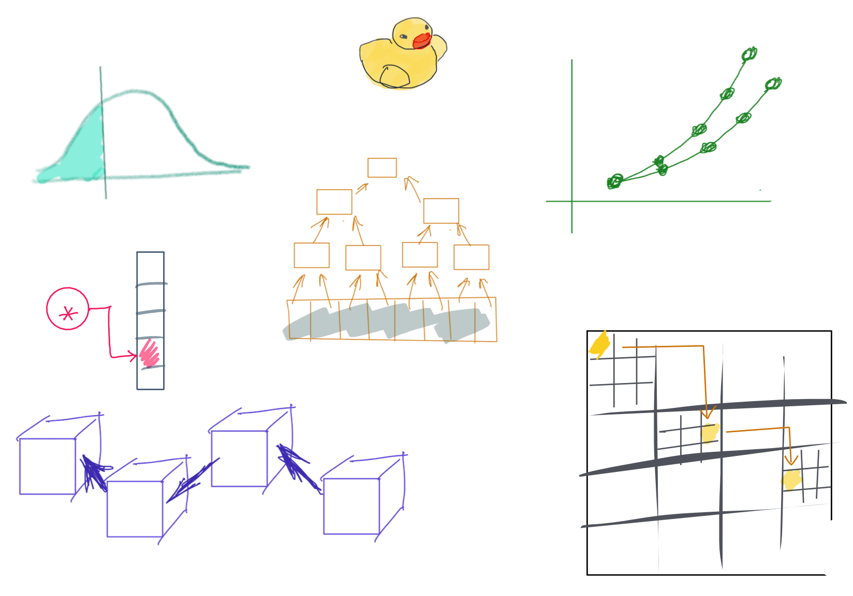

Slide 2
CSS342 Data Structures, Algorithms, and Discrete Mathematics (I)

Slide 3

2nd Week Task Items
Homework Submission Procedures (Wed)
Create a Pull Request GitHub
Homework 1 Review (a separate video to be release Tuesday noon)
C++ Basics (Wed)
Memory, e.g. pointer, reference
More C++ (Fri)
Class type basics (constructor/destructor, copy constructor, operator overload)
Quiz C++ (Fri)
About C++ pointer, reference
Test Driven Development (Fri)
Homework 2 to be assigned on Fri

Slide 4
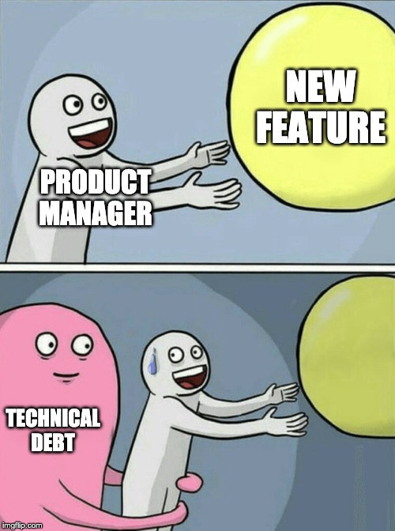
Technical Debt Log
Technical Debt: Topics that you should’ve understood but not yet.
Keep a journal throughout the semester (somewhere only you can see, e.g. a private GitHub repo)
Date | Debt Topic | Plan To Fix | Status
Bring this to 1:1 discussion
Weekly log throughout semester 10pt → extra credit on Final

Slide 5
Study Priority
Lecture PPT
Homework Code
Your code
Given code, e.g. tests
C++
Textbook
In-lecture demo
Code-along
Example code
Your technical debt items

Slide 6
Ask The Right Question
“My code doesn’t work.”
What’s the error/failure?
What have your tried?
Breakpoint?
stackoverflow.com?
Google?

Slide 7
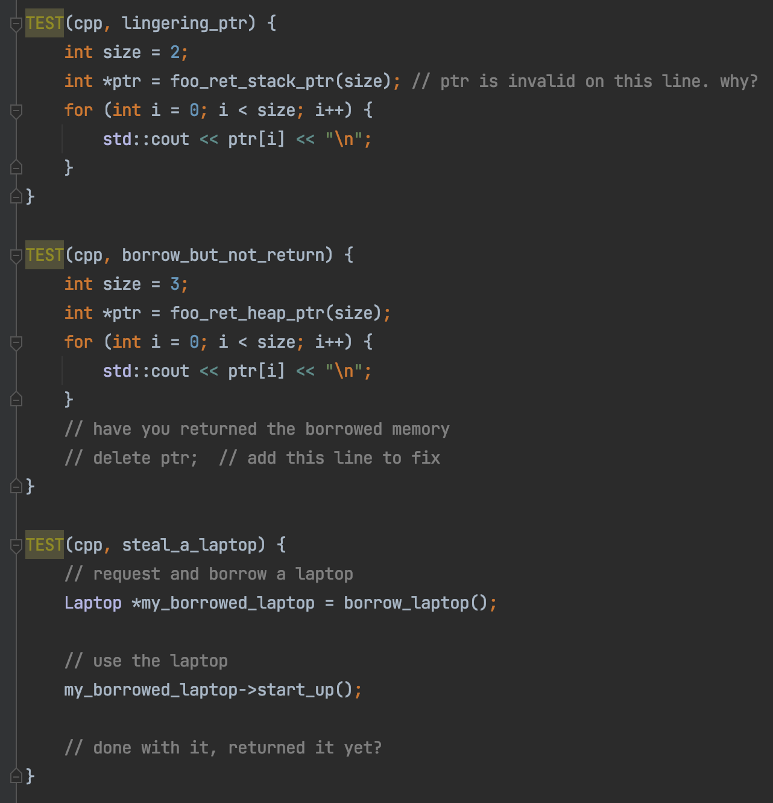
C++ Memory

Slide 8
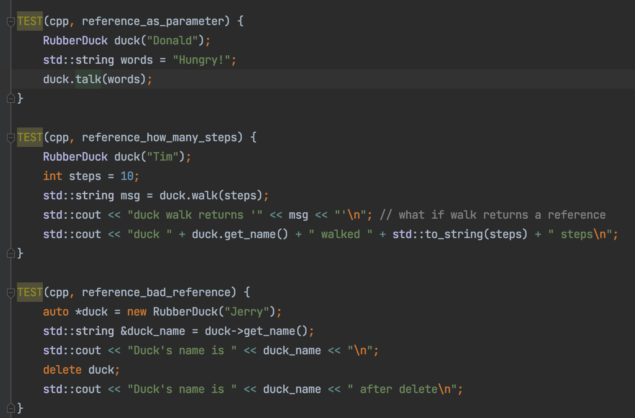
C++ Reference

Slide 9
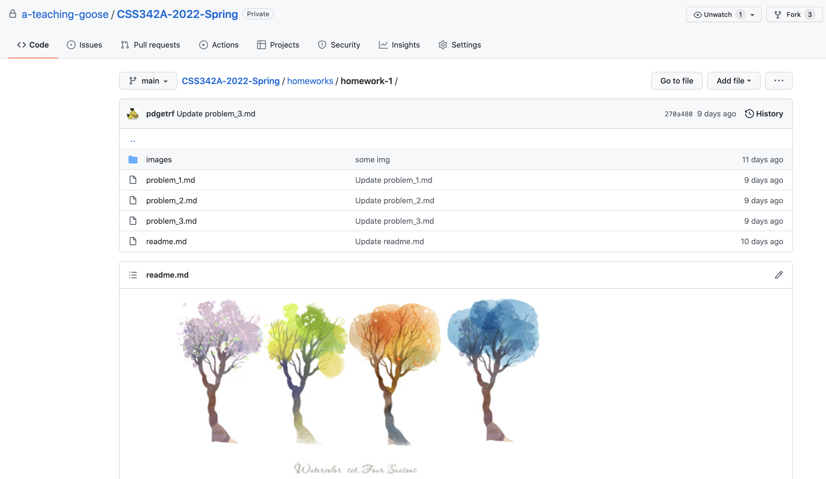
Homework 1 Review
https://github.com/a-teaching-goose/CSS342A-2022-Spring/tree/main/homeworks/homework-1
Detailed review video: https://youtu.be/7pjg2hNfovs

Slide 10

Binary Search
Target: 14
1
3
5
7
9
10
12
12
14
14
18

Slide 11
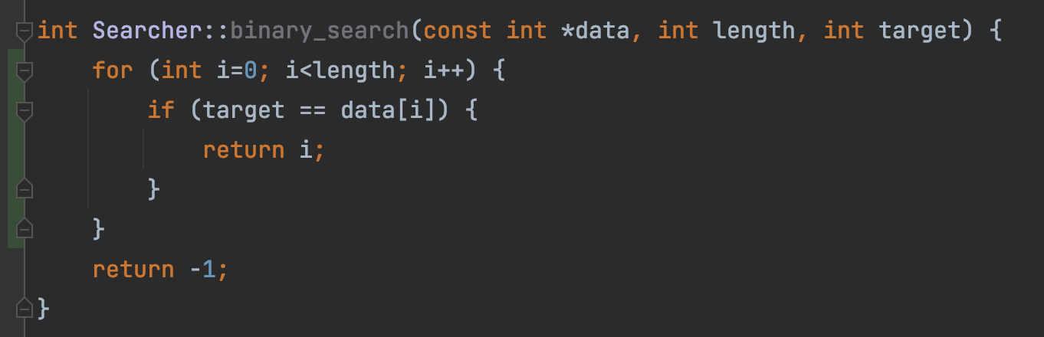
This is linear search, not binary search
“But test passed!”
Test passed
➔ ?
Code is correct
Test failed
➔ ?
Code is wrong

Slide 12
Bubble Sort
9
1
8
7
3
1
9
8
7
3
Round 1
1
8
9
7
3
1
8
7
9
3
1
8
7
3
9

Slide 13
1
8
7
3
9
1
8
7
3
9
Round 2
1
7
8
3
9
1
7
3
8
9

Slide 14
1
7
3
8
9
Round 3
1
7
3
8
9
1
3
7
8
9

Slide 15
1
3
7
8
9
Round 4
1
3
7
8
9

Slide 16
1
3
7
8
9
Round 5
1
3
7
8
9

Slide 17
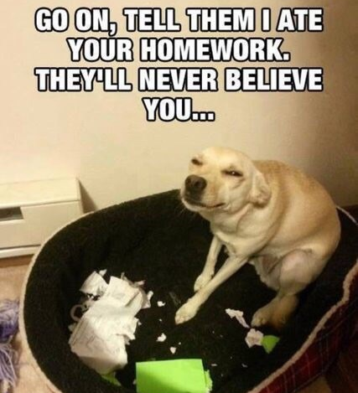
Source Control
“My laptop crashed last night, and my homework is gone”
How do you safely store your code and track changes?

Slide 18
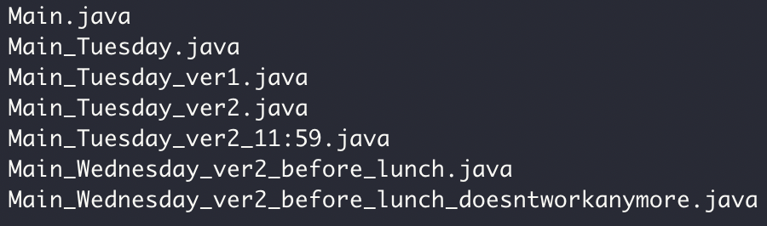

Source Control

Slide 19
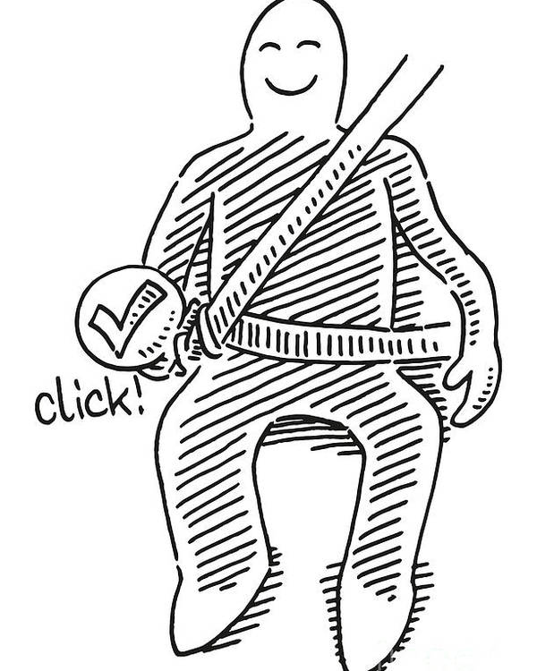
Why Git and GitHub
Widely used in industry and open source projects
Easy to track progress (commits)
Easy to track features (branch)
Easy to collaborate with others (GitHub)
Example: https://github.com/futurewei-cloud/chogori-platform

Slide 20

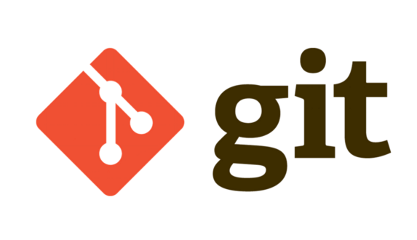
Source Control
Code version 1
Code version 2
Code version 3
“commits”
Code version 1
Code version 2
Code version 3
Code
……
Your computer
Monday
Tuesday
Wednesday
Thursday

Slide 21


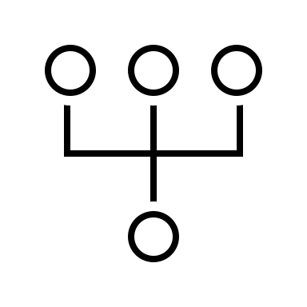
Git/GitHub Terms
Repository, or “Repo”
Collection files from a project
Commit
A snapshot of the repo at the certain time
Branch
A line of development, consisting of a series of commits

Slide 22
Source Control: Branch
Commit 1
Commit 2
Commit 3
Commit 6
Merge, Commit 7
The Main branch
another branch
Commit 4
Commit 5

Slide 23


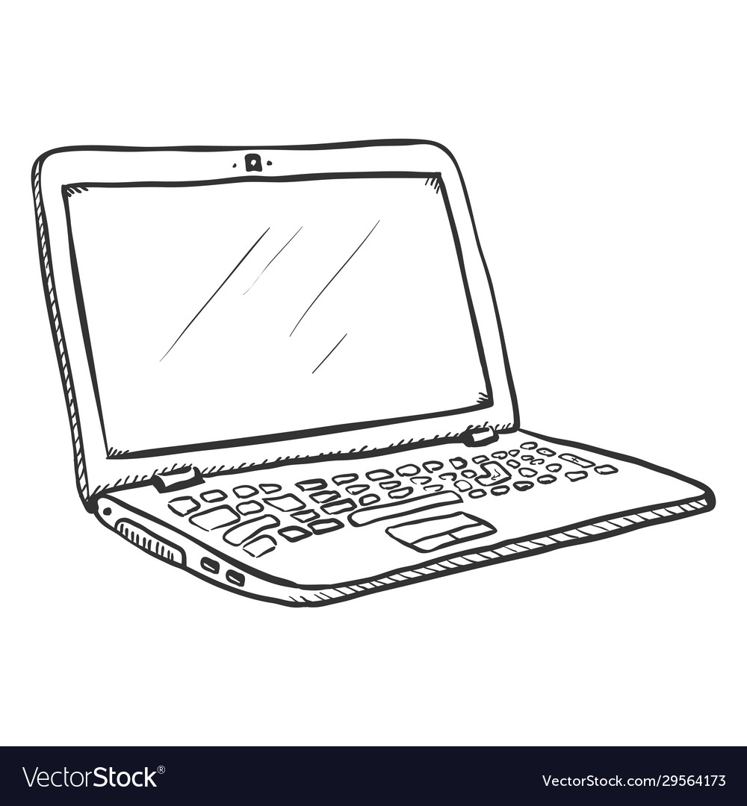
Push
Pull

Slide 24
Pull
Push

Slide 25
Homework repo
Exact Mirror
Homework repo

Slide 26
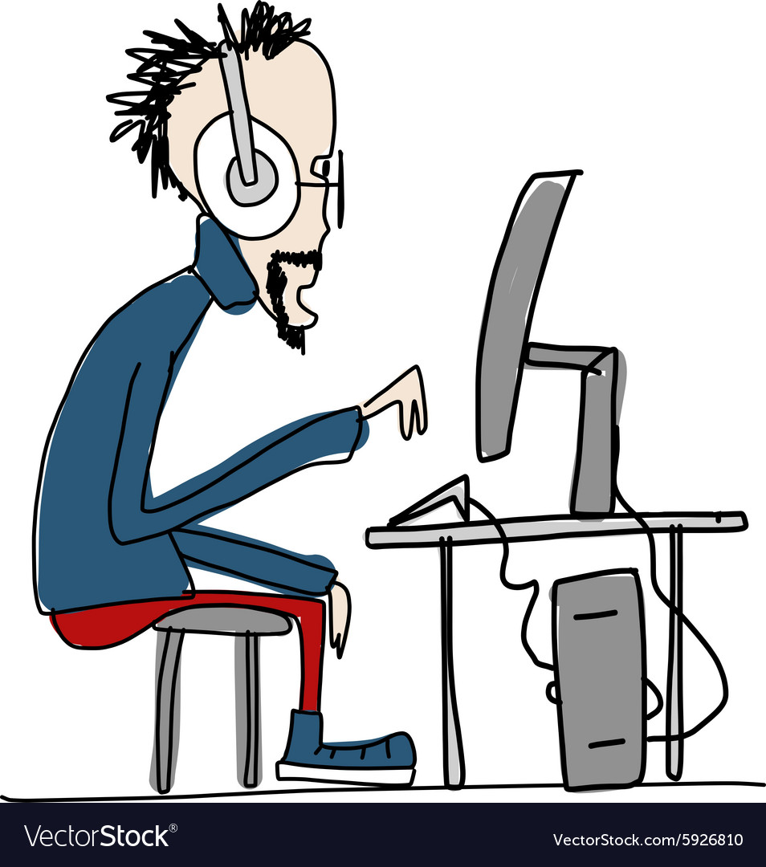
Homework Submission Demo

Slide 27
Submission Task List
Fork the code repo
Enable Action in your repo (can be done any time)
Clone your repo to CLion
Create a new branch (any name you want), and switch to it for work
Write code, commit frequently. Push occasionally.
Create a Pull Request (from your ‘work’ branch to your ‘main’ branch)
Verify all tests pass. Fix issue if anything failed. Push and it runs again.
Submit Pull Request url in Canvas

Slide 28
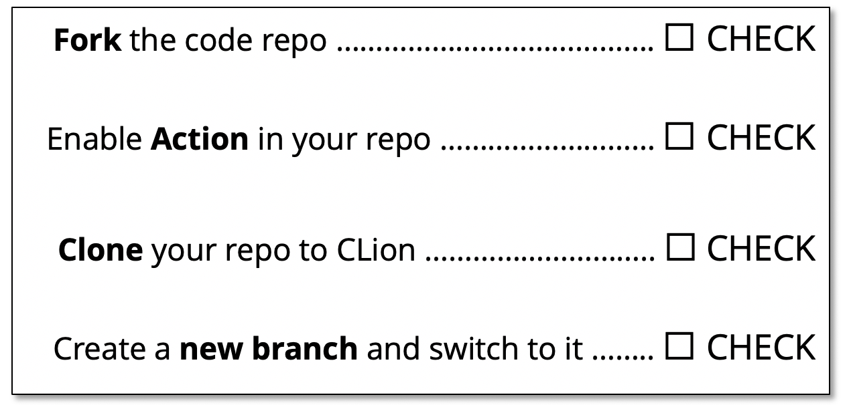
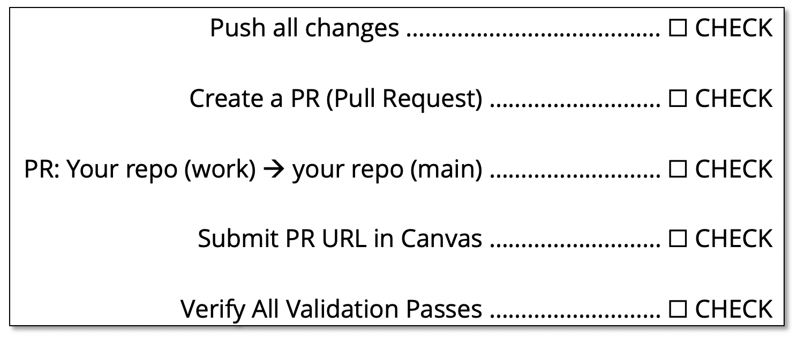
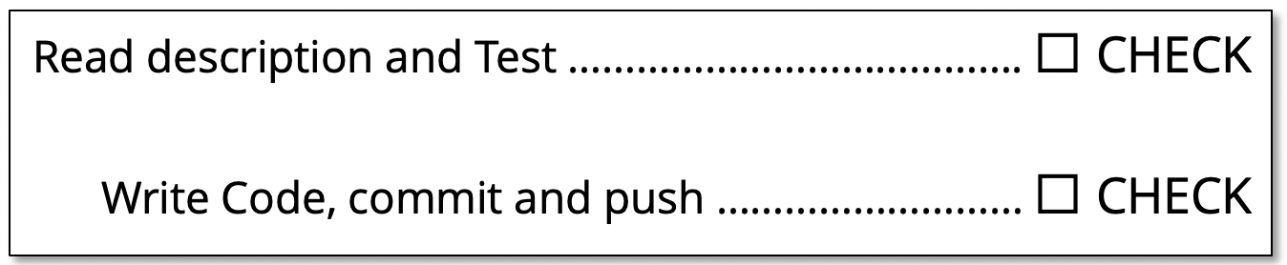
Submission Checklist
https://github.com/a-teaching-goose/CSS342A-2022-Spring/blob/main/homeworks/submission_checklist.md
1
Before Coding Checklist
3
Submission Checklist
2
Coding Checklist

Slide 29
Demo video
The Submission Process
Instructor repo, main branch
Fork (”meaning copy”)
your repo, main branch
Pull Request
This url is what you submit
your repo, Work branch
more commits

Slide 30

Friday Topics
C++ Class
Constructor, Destructor
Copy constructor
Operator overload
OOP
Test Driven Development

Slide 31
Submission Checklist
Fork the code repo …………………………………. ☐ CHECK
Enable Action in your repo ……………………… ☐ CHECK
Clone your repo to CLion ……………………….. ☐ CHECK
Create a new branch and switch to it …….. ☐ CHECK

Slide 32
Submission Checklist
Read description and Test …………………………………. ☐ CHECK
Write Code, commit and push ……………………… ☐ CHECK
Push all changes …………………………………. ☐ CHECK
Create a PR (Pull Request) ……………………… ☐ CHECK
PR: Your repo (work) → your repo (main) ……………………… ☐ CHECK
Submit PR URL in Canvas ……………………… ☐ CHECK
Verify All Validation Passes ……………………… ☐ CHECK

